Slide 1

Woolwich Riverside
Neighbourhood watch – strengthening communities

Slide 2
What is neighbourhood watch?
Its about building community spirit by creating a strong support network
Looking out for our neighbours
Taking pride in where we live
Wanting to live is a lower crime area
We never advocate you putting yourself or others in danger
We ask if you see something that wrong happening – to report it – that’s all

Slide 3
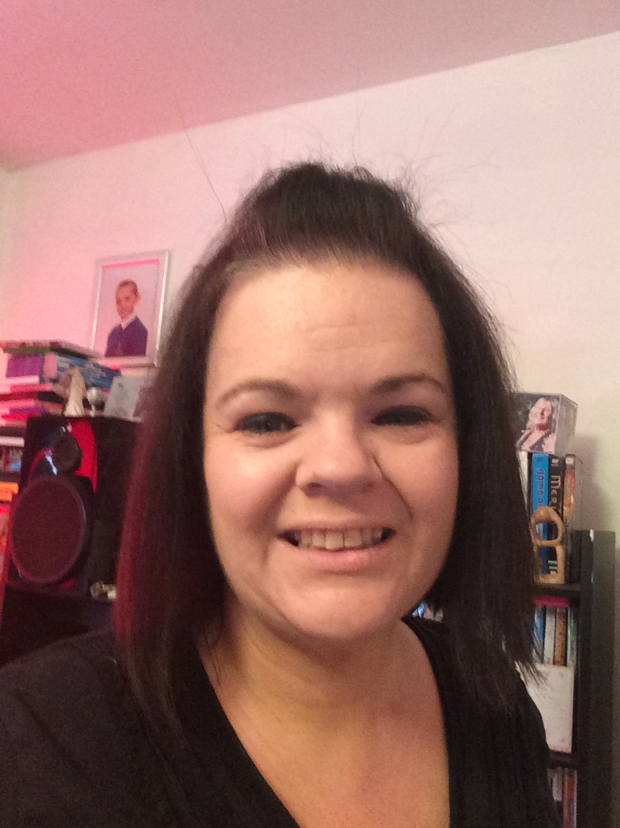
My story
About 2-3 years ago my family, as many do, witnessed a lot of drug activity where we lived. Our youngest child was 6/7 years old with an anxiety issue. My husband is also not well.
We actively reported any activity in our area and was quite confrontational with the perps, this led to my husband being attacked and warned off the reporting.
This just led me to want to do more to get rid of this bad scourge on the area which I lived.
The safer neighbourhood team came on board and supported my family at this time. They stood out in all weathers in the middle of my estate and became a constant presence.
Other neighbours also reported such activates to the police and they acted very quickly, using our information to move the perps off our estate.
So my story begins…..

Slide 4
Woolwich riverside nhw so far
A year ago there were no active neighbourhood watches in our area
Since july last year over 250 people have shown interest or joined our nhw
New watches have been set up by new co-ordinators with support
We promote community involvement 100%
I was asked to be a guest speaker at a crime reduction conference on reducing crime in our community

Slide 5
The birth of Woolwich riverside nhw
In june last year I was approached by pc scott webb of the safer neighbourhood team to start a neighbourhood watch in my area. He offered support and invited me to a nhw conference for Greenwich.
I attended my 1st conference and was asked to join the top table of co-ordinators who would mould and shape nhw in Greenwich!
So from there I started facebook and twitter pages for the whole of the riverside ward.
I was appointed the NHW community engagement co-ordinator for the entire ward

Slide 6

Coffee & conversation
Woolwich riverside is a unique area, a very diverse community ranging from tree lined Victorian terraces, exclusive riverside developments and of course council estates and housing.
So if I just called a nhw meeting would people come? The simple answer is no
So I came up with ‘coffee & conversation’, this is a informal meeting, held in a central location, where we bring together the community and the police and offer crime prevention advice and support, we also provide free tea and coffee.
Our 1st meeting in the dockyard area saw over 14 people turn up and sign up to nhw and 2 new nhw begin – a great start as 1 new member is a start – 14 brilliant!
We have held 3 other coffee and conversation meetings, both in the dockyard area and in the royal arsenal riverside development – all with new members joining everyday
Kinveachey gardens, heathwood gardens and woodland terrace is one of our new watches started, our 1st coffee and conversation meeting for them was great.

Slide 7
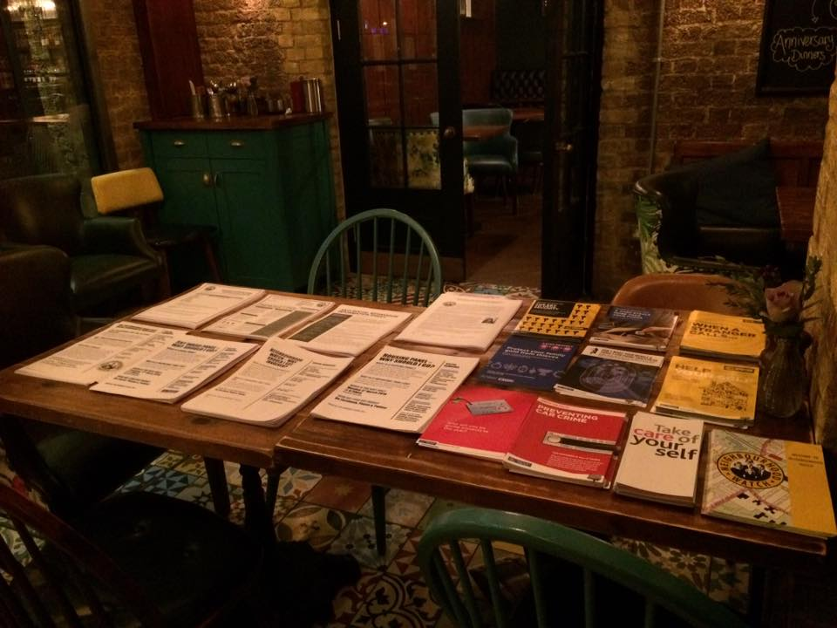
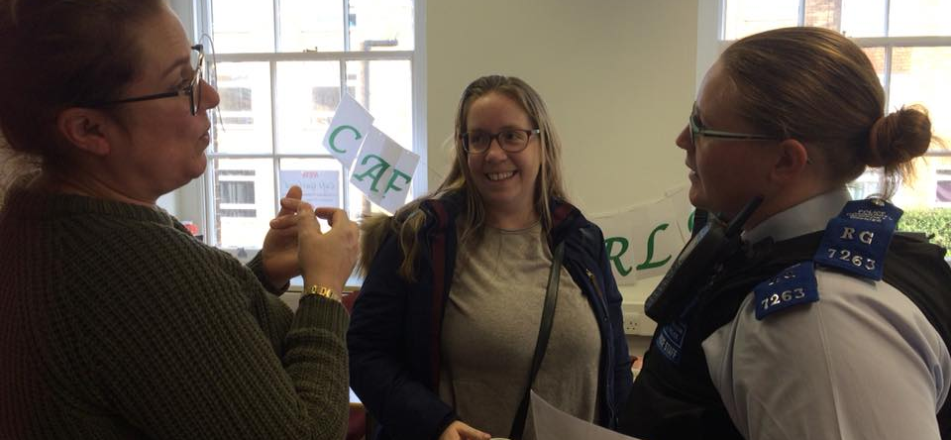
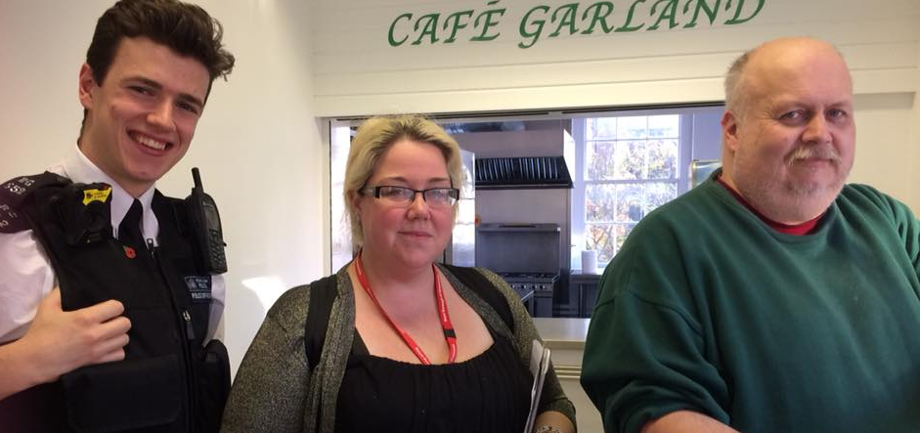
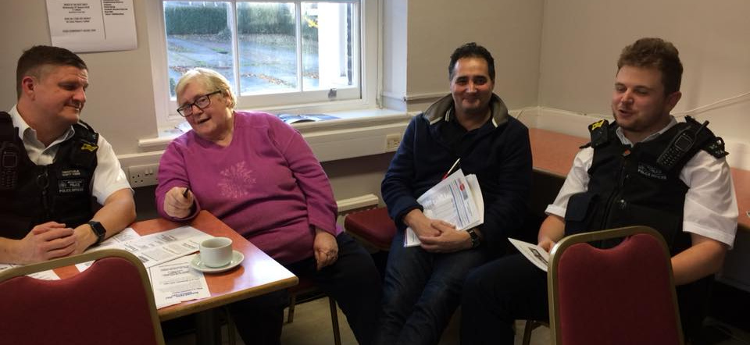
Coffee & conversation

Slide 8

Safer neighbourhood team ward panel
This is a quarterly meeting of local residents, people who work and live in the riverside ward and representatives of various council offices come together with the safer neighbourhood police team and set local priorities for the following 3 months.
It is an opportunity to identify problem areas and concerns which you may have.
Everyone is free to attend and details of this are provided on the facebook pages and in various posters scattered around the ward
This meeting has an agenda and is documented and everything is open for discussion
I am the chairperson of the panel

Slide 9
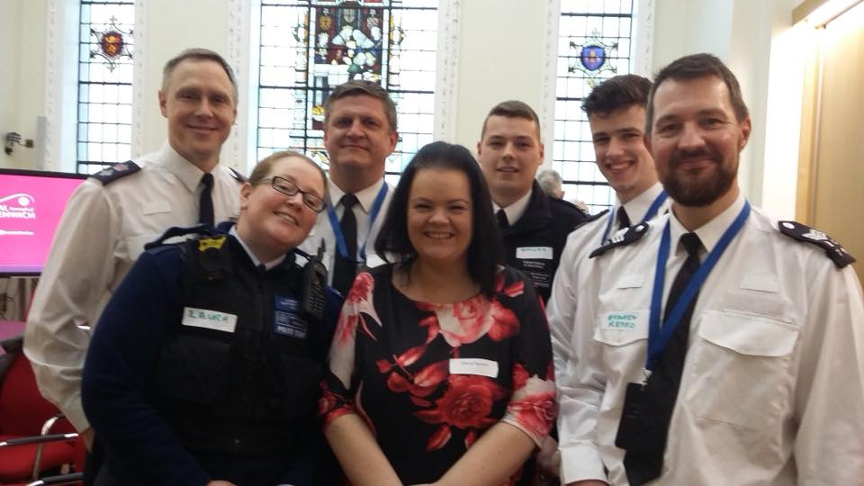
Crime reduction conference with the snt and borough commander

Slide 10
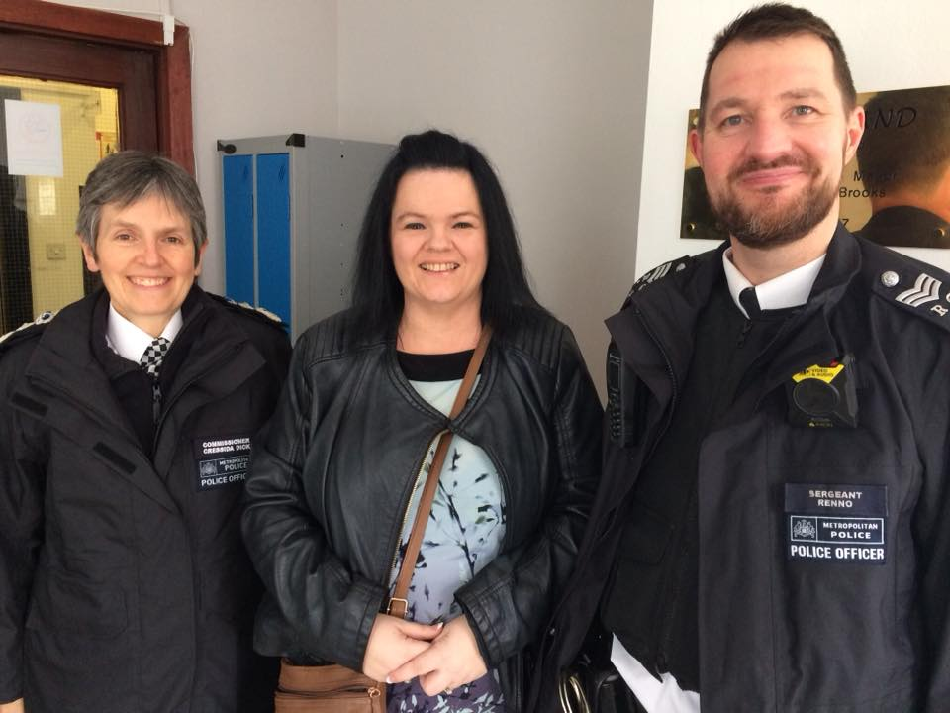
Meeting the police commissioner

Slide 11
Does nhw work?
Simply YES!!
It is proven that by providing a support network and giving crime prevention advice – that it in turn reduces the prospect of crime being commited.
Such as – possessions in a car, we advised our members to hide belongings or to take expensive possession out of the car – this prevented the car being broken into.
If a crime has been committed in your area the co-ordinator is informed by the local snt team and then advises the members what to look out for. Thus this then prevents further crime from happening.
We can set up no cold calling zones, put up signage and know that we all support each other.

Slide 12
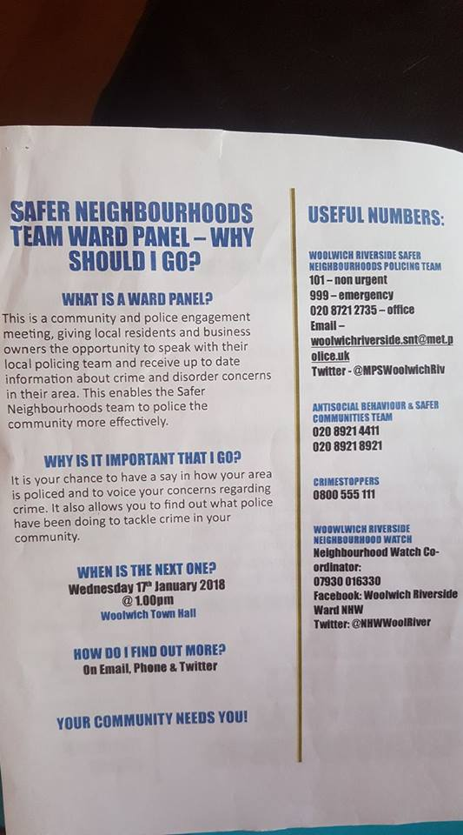
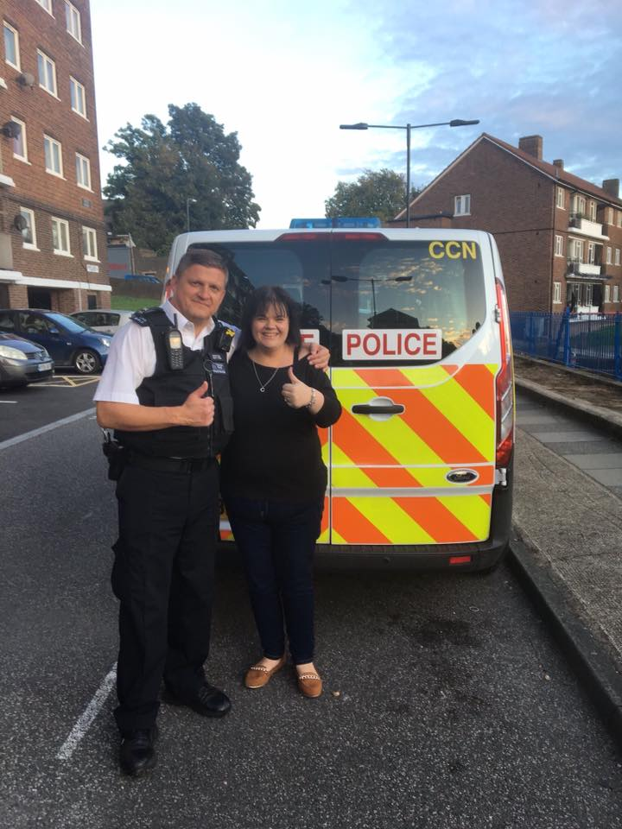
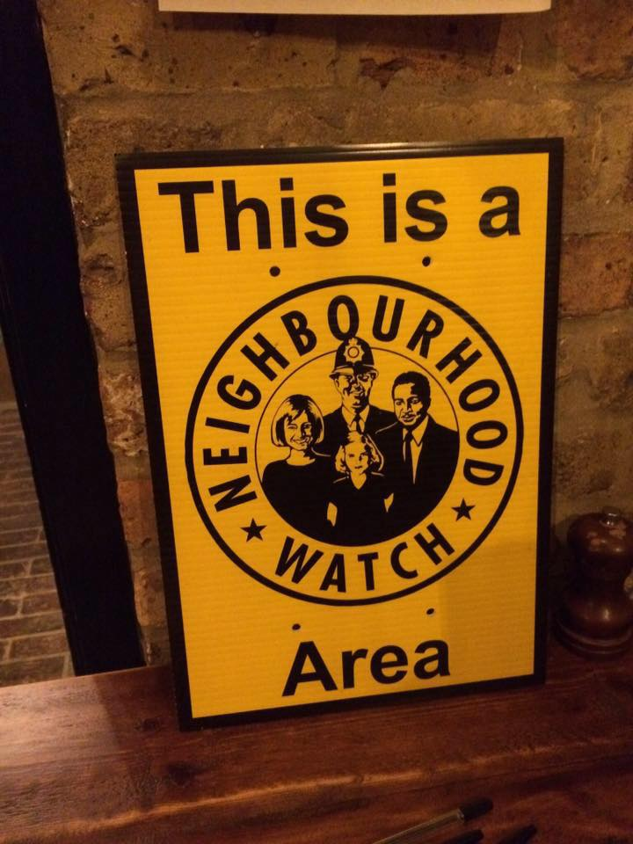
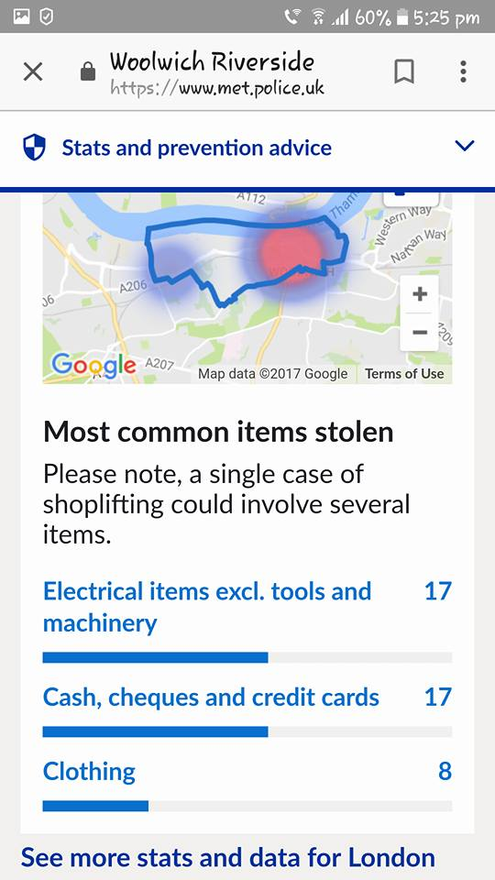

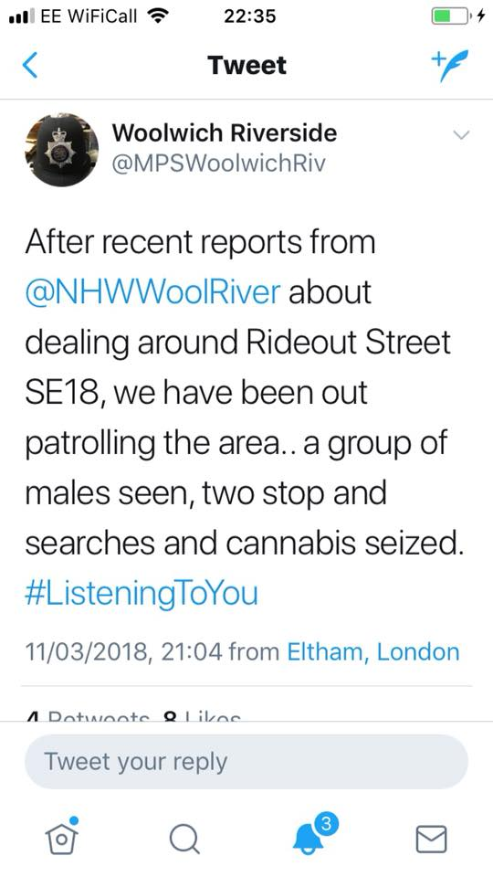
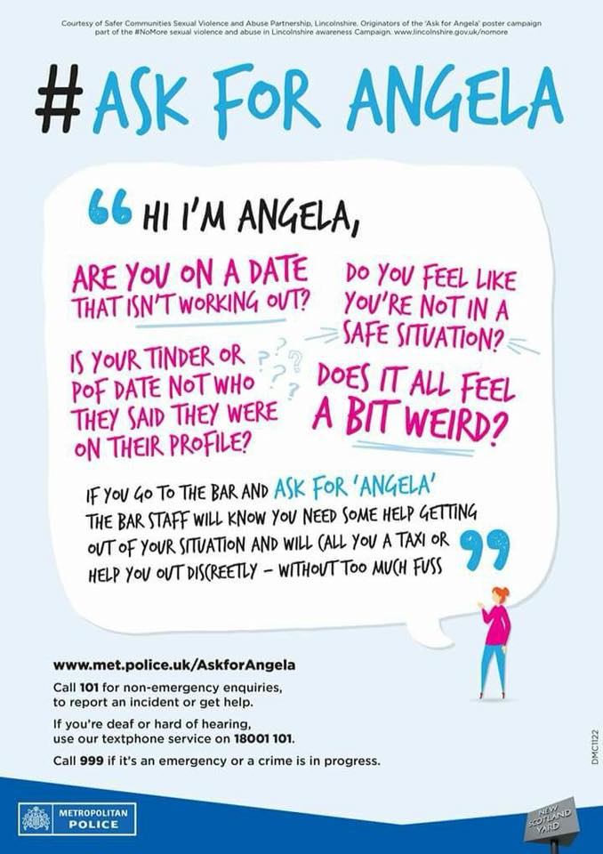

Slide 13
So how can I get involved?
Attend our nhw meetings every couple of months
join and become part of a budding network of support and advice
Become a co-ordinator for the nhw
Come to the ward panel meetings
If you live in a council estate – come along to the housing panel meeting

Slide 14
Nhw Contact details
Facebook: Woolwich riverside ward nhw
Twitter: @nhwwoolriver - woolwichriversidenhw
Email: woolwichriversidenhw@gmail.com
Phone: 07930 016330

