Slide 1
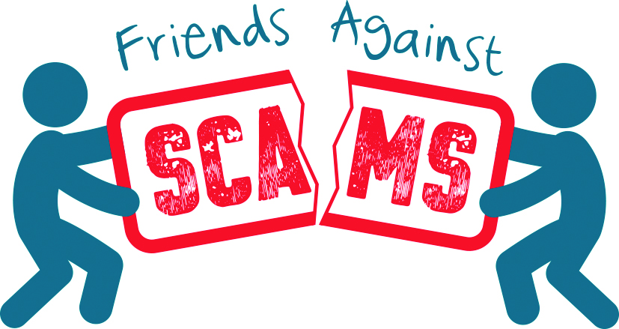

Slide 2
About the National Trading Standards Scams Team

Slide 3
About Friends Against Scams
‘Take a Stand Against Scams.’

Slide 4
Who is who in Friends Against Scams?
Friends
SCAMchampions
SCAMbassadors
Organisations

Slide 5
Why is learning about scams important?

Slide 6
Scams What's the problem?

Slide 7
Oxford Dictionary Definition A ‘Scam’ is a trick, a ruse, a swindle, a racket’ Its nearest synonym is ‘FRAUD’.

Slide 8
“Scams make victims part with their money and personal details by intimidating them or promising cash, prizes, services and fictitious high returns on investment.” National Trading Standards Scams Team (2016)

Slide 9
No matter what type of scam, it is important to remember that ALL scams are CRIMES.

Slide 10
To get victims hooked and responding to scams, criminals rely on…

Slide 11
Loneliness

Slide 12
Vulnerability

Slide 13
Social isolation

Slide 14
Shame
and

Slide 15
The fact that people don’t REPORT that they have been scammed. ONLY 5% of these CRIMES are reported.

Slide 16
Being conned by investment fraudsters, intimidated by doorstep criminals, ‘clairvoyants’ and misled by fictitious lotteries and prize draws.

Slide 17
The average age of a scam victim is 75, showing that criminals tend to prey on older and often more vulnerable members of society.

Slide 18
People defrauded in their own homes are 2.5 times more likely to either die or go into residential care within a year.

Slide 19
This problem is growing. 53% of people aged 65 plus have been targeted by criminals. And it’s only going to get worse.

Slide 20
Once a victim has responded to a scam…

Slide 21
…their personal details are perpetually shared and sold on to other criminals…

Slide 22
…and criminals will use this information to…

Slide 23
…relentlessly target the victim with either scam mail, multiple phone calls, or repeat home visits…

Slide 24
…in order to con, mislead, intimidate and bully the victim into parting with their life savings.

Slide 25
Scam victims SUFFER IN SILENCE.

Slide 26
Victims are often lonely and the criminal is the only ‘friend’ they have.

Slide 27
Leading to situations like these…

Slide 28
Letter from a victim to a criminal
“By the way I never have enough cash at this time in the month, I am really now wondering when I will ever have any win.”

Slide 29
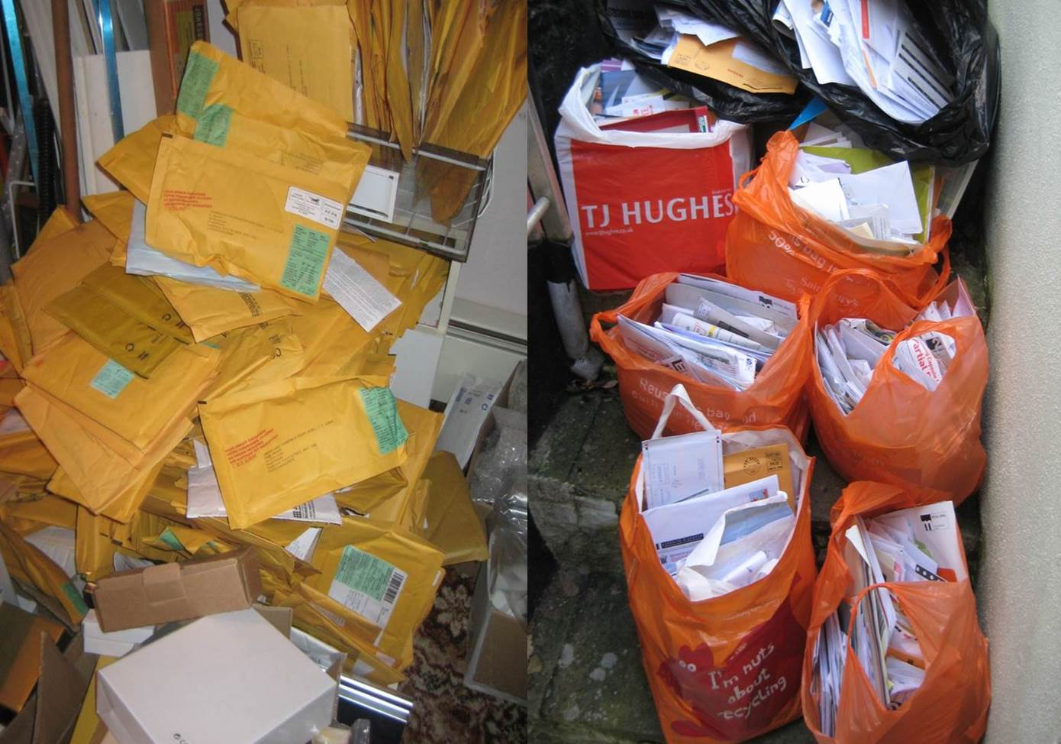
Scam victim’s house.

Slide 30
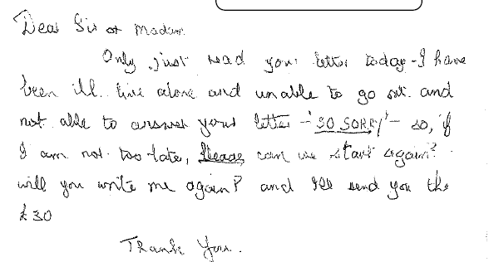
Letter from a victim to a criminal
“So sorry, so if I’m not too late,
PLEASE can we start again?
Will you write to me again and
I’ll send you your £30?”

Slide 31
Leaving the victims to feel like this….

Slide 32
“I get up, I wait for the post, I sort it, I go to bed. What else have I got? I might as well be dead.”
“I hope I win, so I can move to a home. I want someone to talk to.”
“I don’t get out, because I'm frightened. These letters are all the company I ever get.”

Slide 33
One victim was found to have been receiving 30 pieces of mail and 10 phone calls per day.
It was later discovered she had lost over £1 Million.

Slide 34
Another victim agreed to work on her driveway, which resulted in repeat visits over two years; each time she was persuaded to part with more money.
She lost over £160k.
The actual value of the work was only £6k.

Slide 35
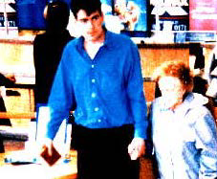
Doorstep Scams victim being escorted to the bank.

Slide 36
The stress and pain of victimisation often results in depression, withdrawal and isolation from family and friends and the deterioration of physical and mental health.

Slide 37
In some cases victims have considered, attempted or committed suicide.

Slide 38
These victims are not going to win the Australian lottery or receive the millions of pounds that are ‘waiting’ for them…
(for a small fee)

Slide 39
As you can see, the problem is immense

Slide 40
Scams cost the UK economy between £5-10 Billion a year.

Slide 41
So, what can be done to help give a voice to these victims?

Slide 42
Together we can…

Slide 43
Talk about scams to highlight the scale of the problem.

Slide 44
Prevent people from becoming a scam victim.

Slide 45
Take away the shame.

Slide 46
Together we can…
TAKE A STAND AGAINST SCAMS!

Slide 47
Five key points about scams
£5 – 10 billion
53%
Anyone
5%
Criminals

Slide 48
Types of scams
Postal scams
Telephone scams
Doorstep scams
Online scams

Slide 49
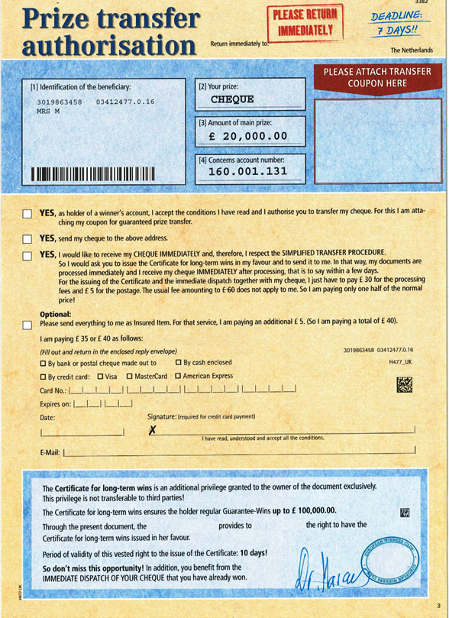
Would you respond?
Customer’s 1st name is used in the letter to make it personal.
Requests money first before getting prize.
Made to look authentic with directors name, picture and signature.
Letter is written to put people under pressure to reply.
Stamps are used to make it look official.
PO Boxes are used instead of full postal address.
Fake testimonials or money back guarantees to make offer seem genuine.
Too good to be true offers.
Made to look dazzling.
Often says to keep their winnings a secret.

Slide 50
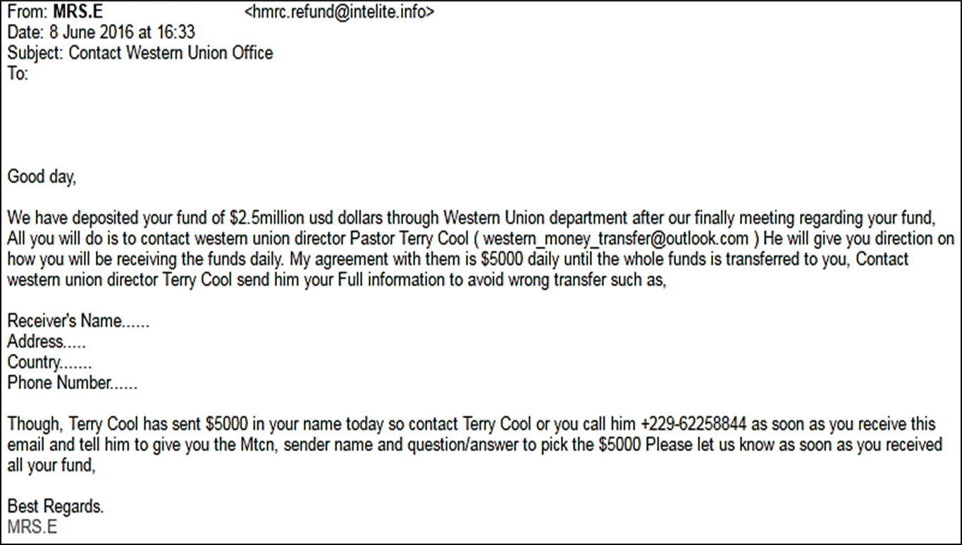
Would you respond?
Inconsistent email address.
Incorrect URL / website links.
Poor spelling and grammar.
Pressure to respond.
Often contains an attachment.
Overuse of capital letters.
Absent or inadequate email signature.
Inconsistent subject and content.
Vague or non-existent subject.
Not addressed to a specific person.
Requests for personal or financial information.

Slide 51
How to spot a victim…
Postal Scams
Post office
Mail
Stamps
Cheque books
Products
Free gifts
Telephone Scams
Phone calls
Payments
SMS messages
Friends
Helpful caller
Opportunities
Doorstep Scams
Poor quality
Unnecessary work
Fearful
Pressure
Cash withdrawals
Online Scams
Suspicious emails
Final demands
Refunds
Online relationship
Payments
Financial hardship and / or self neglect

Slide 52
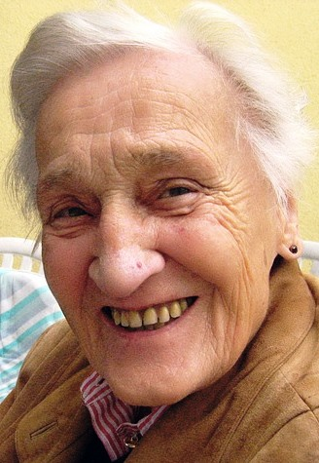
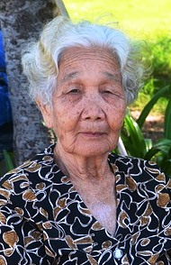
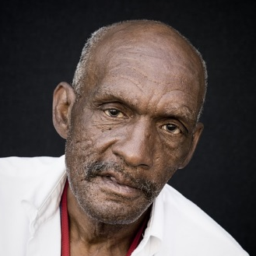
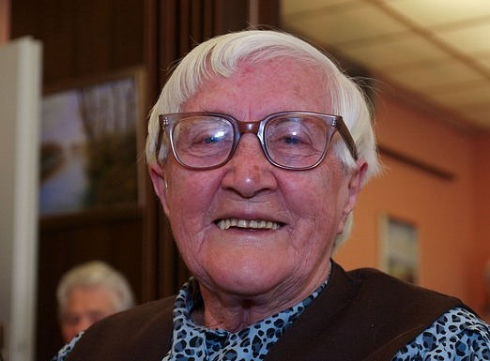
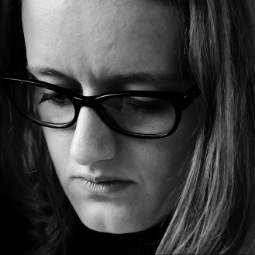
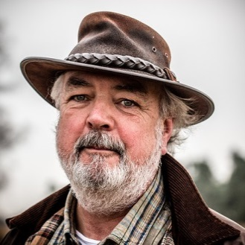
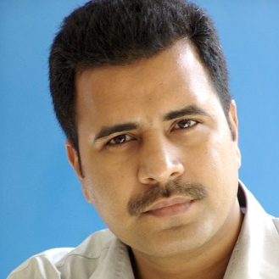
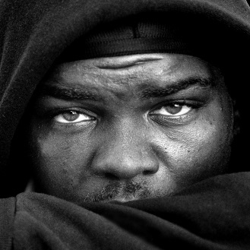
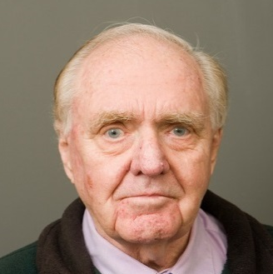
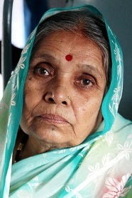
Anyone can be a scam victim.
Health issue
Dementia
Vulnerable
Socially isolated
Lonely
Pressure
Sense of purpose
Targeted by criminals
Trust easily

Slide 53
Consequences of falling for scams…
Attempt or commit suicide
Poor mental, physical or emotional health
Debts
Damaged relationships
Repeat victimisation
More likely to end up in care

Slide 54
Scams are the product of organised, predatory criminals…
…who gain trust to exploit and steal money.
Use befriending and grooming techniques
Appear legitimate
Helpful
Persuasive
Persistent
Friendly
Charming
Threatening
Aggressive
Intimidating

Slide 55
Top tips – what can you do to protect yourself and/or others?
1
Never disclose security details
2
Don’t assume
everyone is genuine
3
Don’t be rushed
4
Listen to your instincts
5
Stay in control

Slide 56
Top Tips - what more can you do?
Talk
Report
Contact bank
Seek further help

Slide 57
Call blocking
Protect from nuisance and scam calls
Extra safety for vulnerable users
Part of phone
Separate unit

Slide 58
Scam Marshal
Scam Marshals send in their scam mail to the investigations team (Freepost)
They can talk to family and friends about the good work they do to help raise awareness
The investigators use their mail to help prosecute and close down the criminals
They help to take a stand against scams – sign up today if you think you can help
Notes:
- Where appropriate, removes the shame from scams, Increases wellbeing, confidence & happiness. Hand out leaflets at this time.

Slide 59
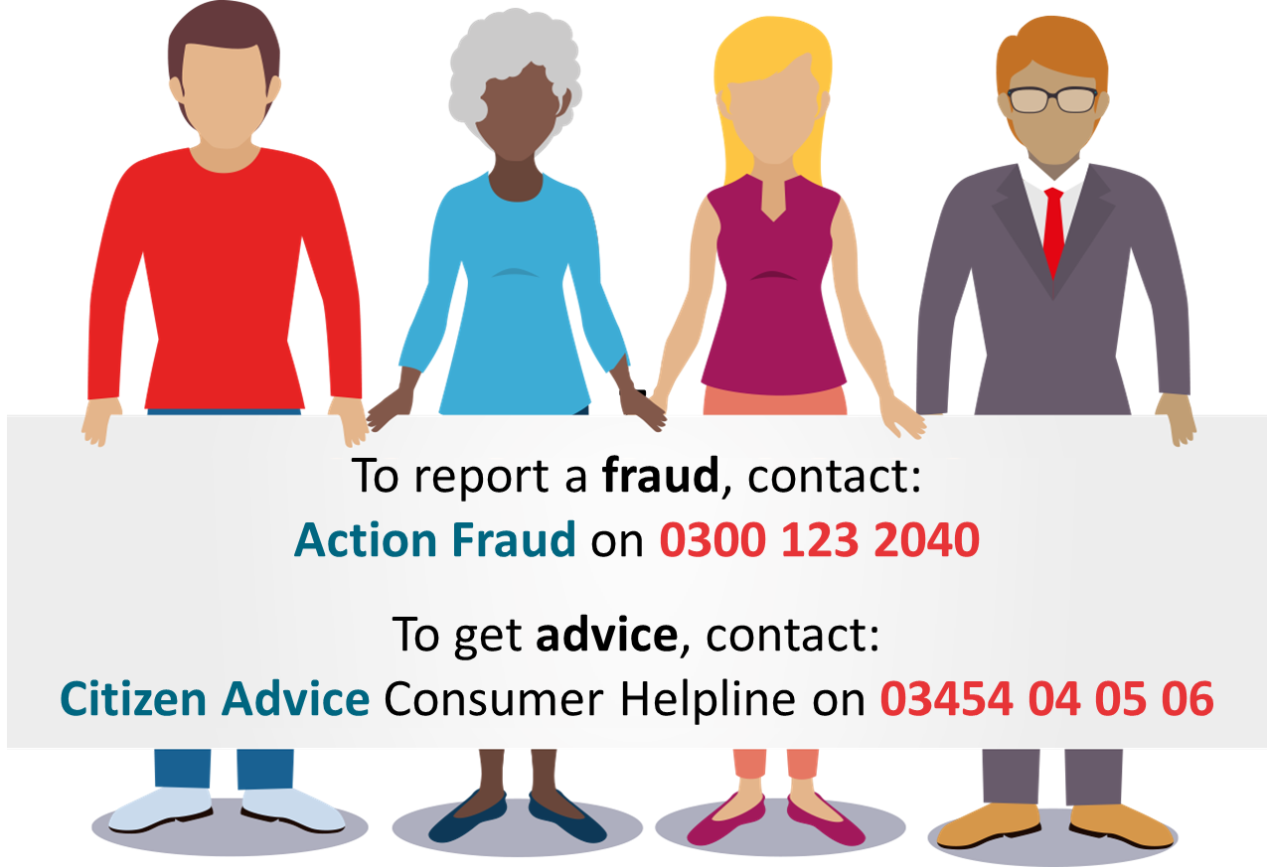

Slide 61
Congratulations! You are now a Friend Against Scams.
Music: www.bensound.com

Slide 62
What’s next?

Slide 63
Make a pledge and turn your knowledge into action.

Slide 64
Some example pledges to get you thinking about what you can do:

Slide 65
1. Tell five people about scams and the Friends Against Scams initiative.
2. Encourage someone you know to visit the Friends Against Scams website.

Slide 66
3. Share your Friends Against Scams status on social media.
4. Look out for people in your community who are at risk of being a scam victim.

Slide 67
5. Actively support your local fight against scams by setting up or taking part in a scam awareness activity or event in your local area.
6. Campaign for change by writing to your local MP asking them to promote scams awareness.

Slide 68
So, what will be your pledge?

Slide 69
Thank you for joining us today
Visit us online for all the latest news and information about Friends Against Scams:
www.friendsagainstscams.org.uk

