Slide 1

What can we do about...
Antisocial Behaviour
Greenwich Neighbourhood Watch Network
www.greenwichnhwconnect.org

Slide 2
What is antisocial behaviour?
Antisocial behaviour is defined as 'behaviour by a person which causes, or is likely to cause, harassment, alarm or distress to persons not of the same household as the person'
(Antisocial Behaviour Act 2003 and Police Reform and Social Responsibility Act 2011).

Slide 3
If your quality of life is badly affected by other people in your community then you could be a victim of antisocial behaviour.
noise nuisance
neighbour disputes
verbal abuse
threatening behaviour
harassment and intimidation
vandalism
criminal damage.

Slide 4
Three main areas of ASB
Personal
Nuisance
Enviromental
is when a person targets a specific individual or group.
is when a person causes trouble, annoyance or suffering to a community.
is when a person’s actions affect the wider environment, such as public spaces or buildings.

Slide 5








Nuisance calls
Cold calling
Abandoned vehicles
Animal issues
Cars mowing up & down street
Trespassing
Misuse of fireworks
Rowdy & Inconsiderate behaviour
Street Drinking
Begging
Prostitution
Nuisance Neighbours
Litter & Drug paraphernalia

Slide 6
What antisocial behaviour isn't...
  Parking (including badly parked vehicles)
  Children playing
  Neighbours doing DIY (at reasonable times of the day)
  Groups of people in the street or in parks, unless they are being rowdy, abusive, causing damage or committing other crimes
  Noise caused by everyday living
  Religious or cultural practice
  A one-off party
  General living noise

Slide 7
The impact of Antisocal Behaviour...
Anyone can experience antisocial behaviour and it can affect you in many ways.
You may find that:
  you can’t sleep
  you feel anxious and constantly on edge
  you are frightened to go out
  you don’t feel safe in your own home
  your children are upset
  you change your routine to avoid problems
  you want to move
  you can’t talk to anyone about it
  you feel you must have done something to cause it
  you think nothing will change and it will never end.

Slide 8
So what can WE do?

Slide 9
You might think that an incident is small or unimportant to start with, but antisocial behaviour can go on for a long time, and become very serious. Not all antisocial behaviour is classed as crime but a lot is, or can become a crime. We can support you even if the police are not involved, but nothing will change if you don’t take action.

Slide 10
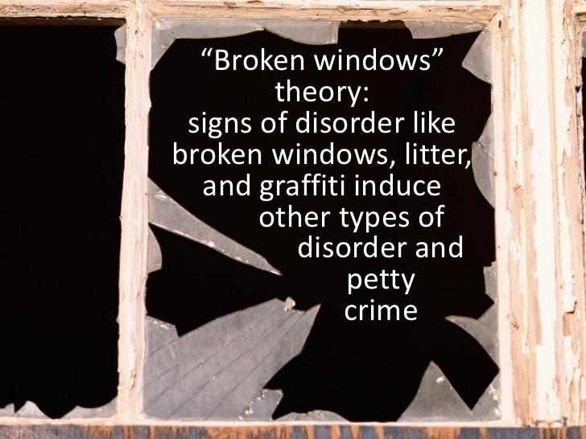
Have you heard about the broken window effect?
If no one cares, criminals have free range

Slide 11
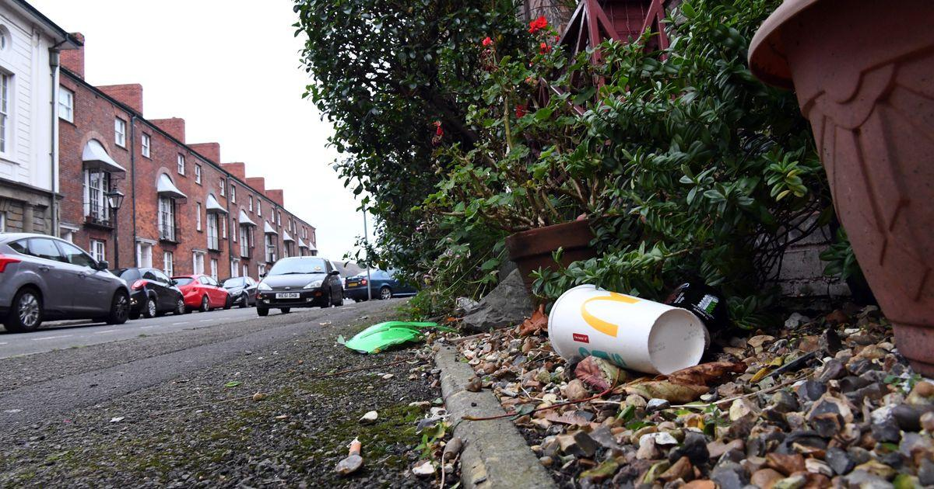
Litter
Encourage your community to not drop litter
If bin men leave litter behind - report them
Make sure you put your litter securely in the bin

Slide 12
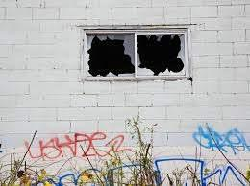
Graffitti
Unsightly graffitti
really brings a
community's look
down.
Report to council via FixMyStreet.com app

Slide 13
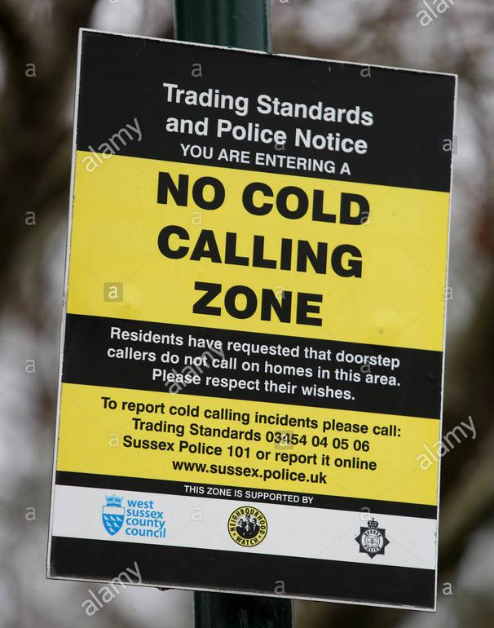

Set up NO COLD CALLING zones
Make your community work smarter

Slide 14
What are the council doing?
PSPO - Public Space Protection Orders
Designing out crime
Tenancy Enforcement
ASB Officers
Joint Partnership Working
Enviro-crime unit

Slide 15


Working together, we are stronger
POLICE
COUNCIL
YOU

Slide 16
Reporting ASB
So who should you report it to? It’s important to tell the right people about what is going on. You can report to:
POLICE
LANDLORD
COUNCIL

Slide 17
Why should we report? Nothing ever gets done....
Sometimes, unfortunately, ASB can go on for a long time and during that time the person affected by the ASB and those who live in the community can become disolutioned that nothing is happening.
FACT
Unless the police and council know what is going on - EVERYTIME - then they cannot do anything about it
FACT
In order to do anything about ASB, there is a need to build the case, the evidence, to prove that ASB is happening. In the same way the police and council have to build a case, with EVIDENCE, to ask for a conviction etc, so must we provide that evidence

Slide 18

Keep a diary
Do not understimate the value of keeping a diary record of events
Note down the DATE, TIME, BEHAVIOUR
Don't forget to write down how it made you feel
Many councils have diary sheets available

Slide 19
Important contact numbers
Private residents
If it's an incident that has already happened and doesn't need an immediate response, call the national Police non-emergency number, 101.
You can report non-urgent incidents to the Anti-Social Behaviour Team at contact-centre@royalgreenwich.gov.uk or on 020 8921 4411.
If it's an ongoing situation, keep a record of the events in a diary noting the dates, times, what you see or hear and how the behaviour affects you.

Slide 20
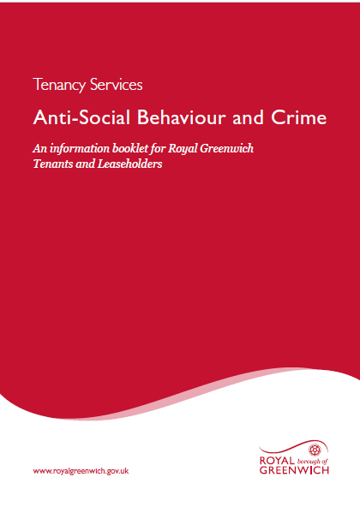
Important contact numbers
Council and housing association tenants
If you're a council tenant or leaseholder, contact the Housing Services team at central-neighbourhood-office@royalgreenwich.gov.uk
Download the information booklet from
RBG website

Slide 21
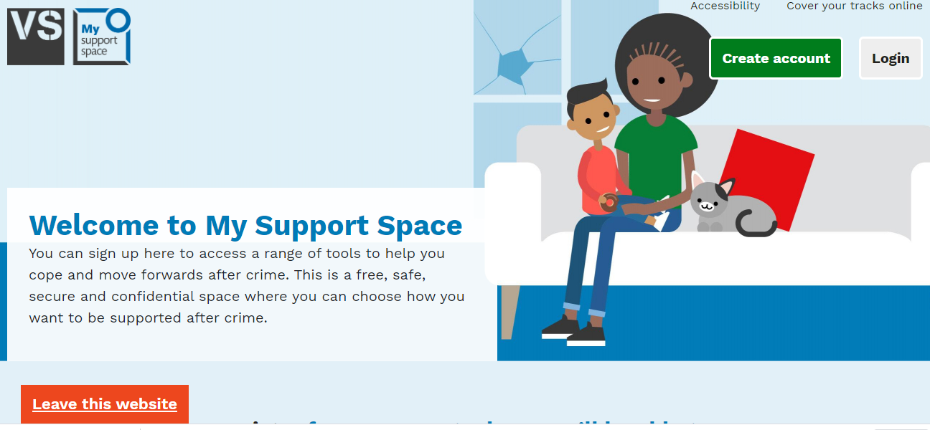
Access to help and support
Victim Support - https://www.victimsupport.org.uk/crime-info/types-crime/antisocial-behaviour
Supportline for free on 08 08 16 89 111
www.mysupportspace.org.uk - Victim Support Help

Slide 22
Other help and support
ASB Help - https://asbhelp.co.uk/
Resolve - ASB Charity - https://www.resolveuk.org.uk/
Crimestoppers - 0800 555111

Slide 23
Neighbourhood Watch
  Has a membership of over 2.3m across England & Wales
  Communities coming together to support each other
  Proven to help reduce the fear of crime
  30% reduction in burglary - 6 mths prior to lockdown
  Works in partnership with community groups, council and police
  Increases resilience by raising awareness
  Run by the community for the community

Slide 24
Thank you for listening
www.greenwichnhwconnect.org

